Slide 1
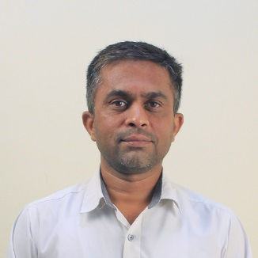
Unit-4 Cloud for IoT
IOT and Applications
GTU # 3160716
Prof. Kalpesh H Surati
Computer Engineering Department
Kalpesh.surati@darshan.ac.in
+91 99250 10033

Slide 2
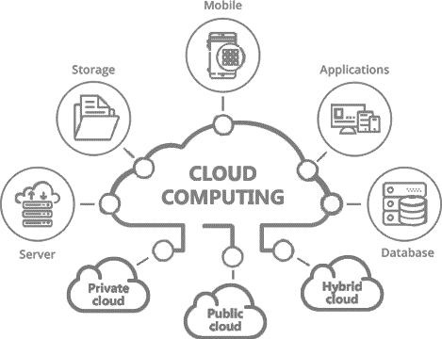
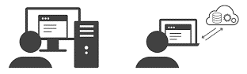
Introduction to Cloud Computing
Cloud computing is the delivery of computing services over the internet, by providing flexible, affordable, effective and efficient resources for development.
That includes servers, storage, databases, networking, software, analytics, and intelligence.
Cloud computing provide economical freedom along with technical strength to the application.
In other word, it is about outsourcing of IT services and infrastructure to make them available anywhere via the Internet.
Application logic runs
on user’s computer
Application logic runs
in the cloud

Slide 3
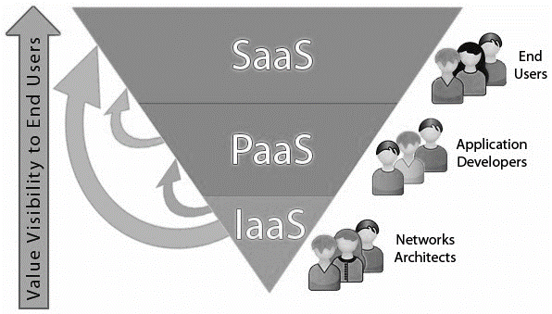
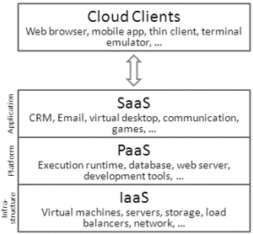
Service Models of Cloud Computing
There are three main service models of cloud computing – Infrastructure as a Service (IaaS), Platform as a Service (PaaS) and Software as a Service (SaaS).
Each model represents a different part of the cloud computing stack.
Each type of cloud service provides you with different levels of control, flexibility, and management.

Slide 4
Example of “as a Service”
Pizza as a Service
Traditional
On-Premises
Infrastructure
as a Service (IaaS)
Platform
as a Service (PaaS)
Software
as a Service (SaaS)
Dining Table
Soda
Cheese
Toppings
Tomato Sauce
Pizza Dough
Oven
Fire
Dining Table
Soda
Cheese
Toppings
Tomato Sauce
Pizza Dough
Oven
Fire
Dining Table
Soda
Cheese
Toppings
Tomato Sauce
Pizza Dough
Oven
Fire
Dining Table
Soda
Cheese
Toppings
Tomato Sauce
Pizza Dough
Oven
Fire
You Manage
Vendor Manage
Made at Home
Take and Back
Pizza Delivered
Dined at Restaurant

Slide 5
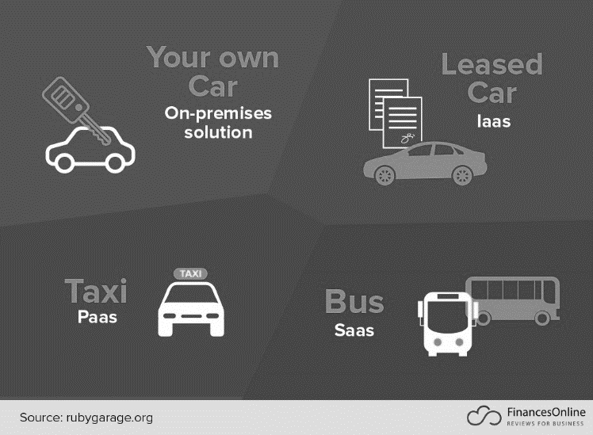
Example of “as a Service”
Vehicle
as a
Service

Slide 6
Cloud Services
Traditional
On-Premises
Infrastructure
as a Service (IaaS)
Platform
as a Service (PaaS)
Software
as a Service (SaaS)
Applications
Data
Runtime & Middleware
OS
Virtualization
Networking
Storage
Servers
Applications
Data
Runtime & Middleware
OS
Virtualization
Networking
Storage
Servers
Applications
Data
Runtime & Middleware
OS
Virtualization
Networking
Storage
Servers
Applications
Data
Runtime & Middleware
OS
Virtualization
Networking
Storage
Servers
You Manage
Vendor Manage

Slide 7
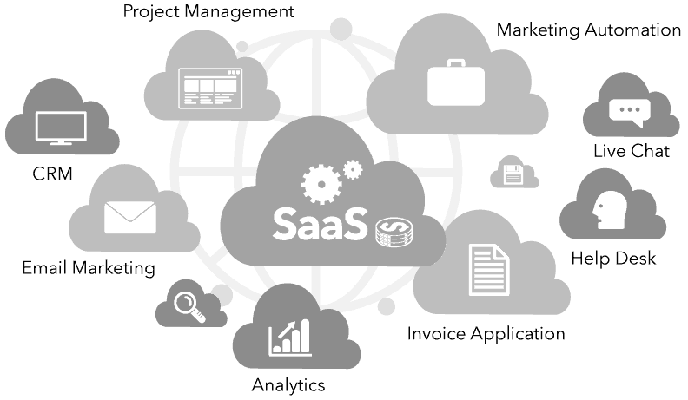
Software-as-a-Service (SaaS)
Complete software application as a service is provided to the user that is run and managed by the service provider.
It can also be called application as a service as a pay monthly, yearly etc. subscription.
In SaaS, user don't need to worry about software upgradation and management.
A common example of a SaaS application is web-based email where you can send and receive email without having to manage the server that the email program is running.

Slide 8
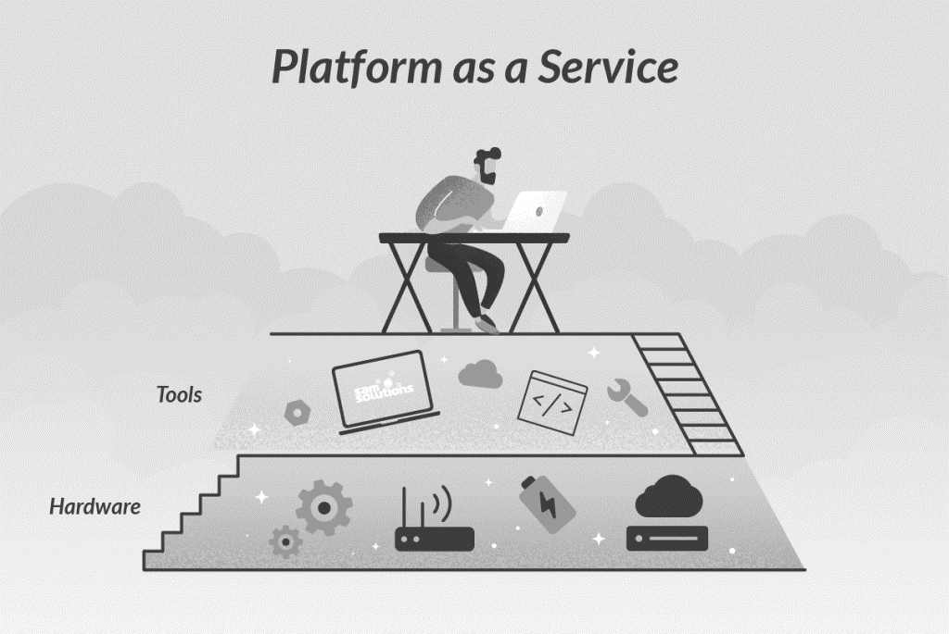
Platform-as-a-Service (PaaS)
It provides a development environment to application developers.
Operating system, programming-language execution environment, database, web server, development tools, APIs, libraries, etc., will be provided by the cloud service provider.
Users have to build, manage and maintain the applications.
Application developers develop and run their software on a cloud platform instead of directly buying and managing the essential hardware and software layers.
AWS Lambda, Google App Engine, IBM Cloud Foundry, Oracle Cloud Platform, Red Hat OpenShift, Zoho Creator.

Slide 9
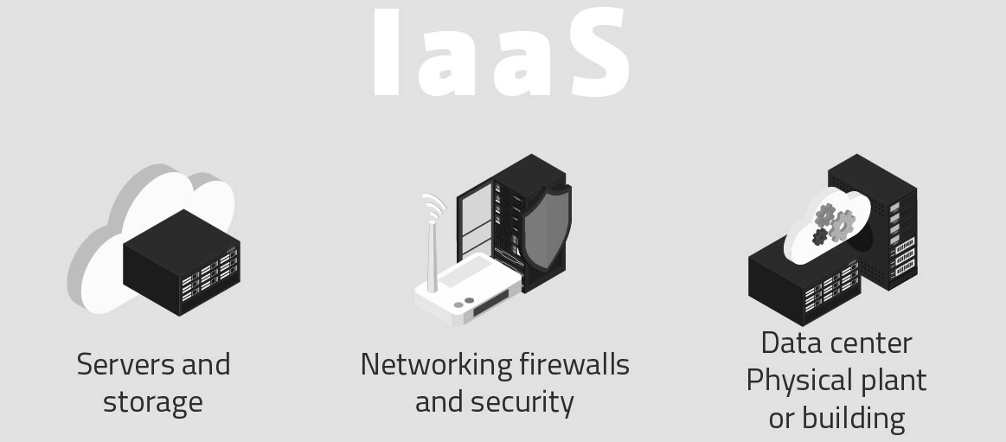
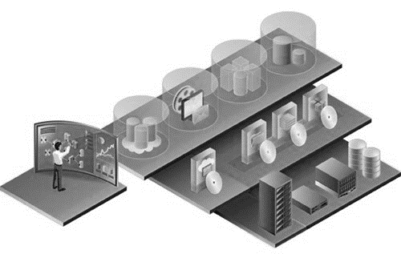
Infrastructure-as-a-Service (IaaS)
IaaS provides access to computing hardware, networking features, and data storage space.
Where the consumer is able to deploy and run software, which can include operating systems and applications.
The consumer does not manage or control the underlying cloud infrastructure but has control over operating systems, storage, and deployed applications
This service provides you with the highest level of flexibility.

Slide 10
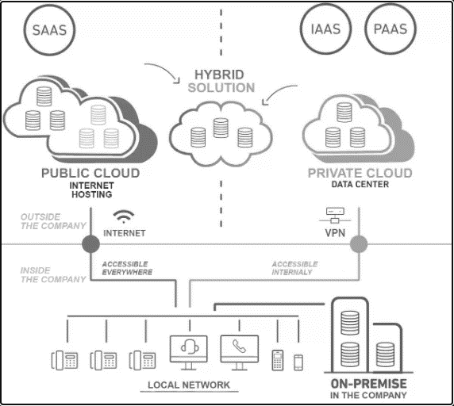
Deployment Models of Cloud Computing
Deployment models of cloud computing are categorized based on their location as public, private or hybrid cloud
It is often possible to choose a geographic area to put the data “closer” to users.
More the money you pay, better in comfort and service

Slide 11
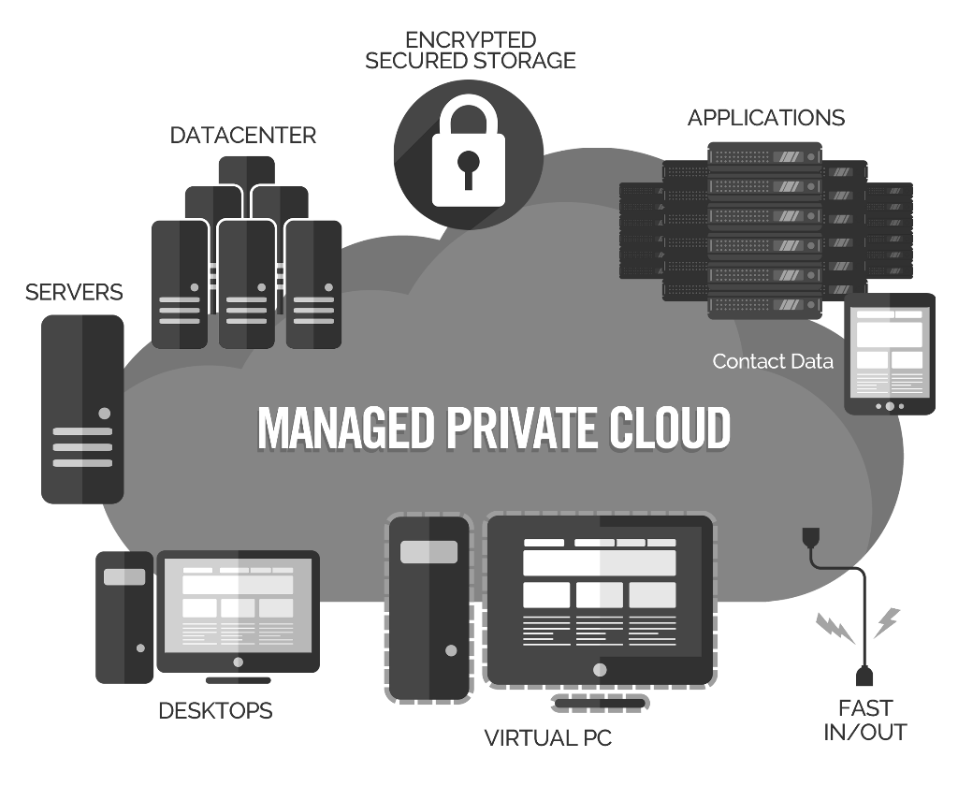
Private Cloud
Private cloud provides computing services within the organization’s private network and selected other users.
In this cloud model all the hardware, software, datacenter, employees, infrastructure, etc., are maintained, monitored, and installed by the organization.
This particular deployment model can be chosen wherever confidentiality matters the most.
Advantages
High level of security and privacy
More control flexible in terms of deciding and managing the resources
Disadvantages
Very Expensive
Need technical skill for maintaining and difficult to management
Policies and other related things are to be framed carefully to make sure that the data is safe

Slide 12
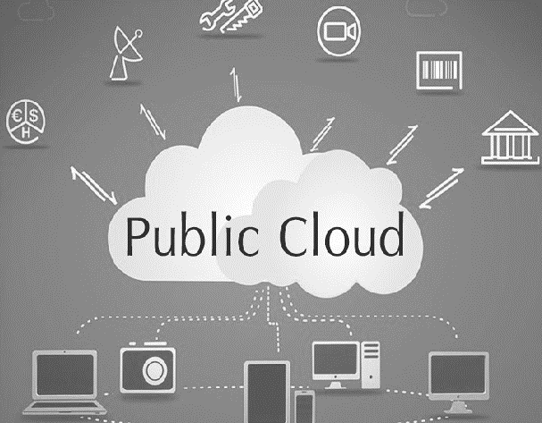
Public Cloud
The cloud resources are owned and managed by a third-party cloud service provider.
Pay as per usage approach makes it most cost effective model.
Advantages
Inexpensive model, no need to invest in setting up the infrastructure and maintenance
Less technical skill required
Customer support team can be reached on demand
Easily scaled up or scaled down based on requirements
High reliability—a vast network of servers ensures against failure.
Disadvantages
Security and privacy issues are the major challenges
Less flexibility and controls

Slide 13
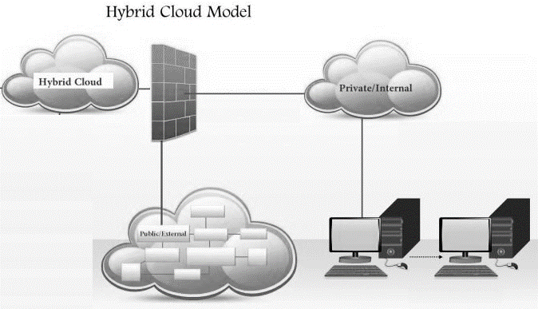
Hybrid Cloud
This deployment is a mix of both private and public cloud deployment
The resources offered and managed are both in-house and third party based
Advantages
Less investment needed to setup the infrastructure
Less technical skill required to manage and maintain the cloud
Customer support team can be reached on demand
Easily scaled up or scaled down based on requirements
Disadvantages
Security and privacy issues are the major challenges
Less flexibility and controls compare to public cloud

Slide 14
IoT with Cloud - Challenges
IoT Cloud Challenges
Privacy and Security
Bandwidth Cost
Migration and Portability
Availability, Reliability and Robustness
Expertise
Costing
Data Ownership
We have already discussed the challenges of IoT and cloud.
These challenges can be increased when the IoT and cloud are integrated.
Here we will discuss seven such challenges
Privacy and Security
Bandwidth Cost
Migration and Portability
Availability, Reliability and Robustness
Costing
Data Ownership
Expertise

Slide 15
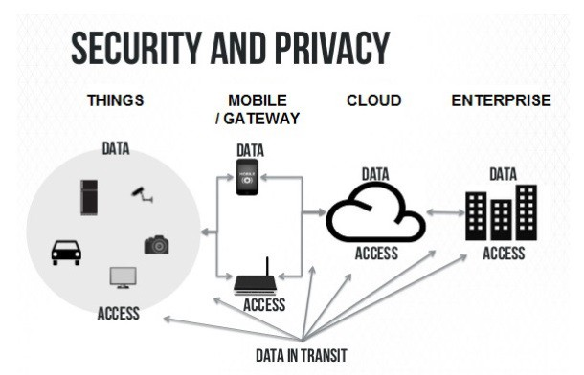
Privacy and Security
Security is a major concern in the field of IoT.
Valuable data goes into the cloud, outside the firewall this data becomes hackable.
The following are solutions to this privacy and security challenge.
Periodic monitoring of the network activities
Select private cloud if the data is confidential
To reduce the risk of being exposed, use recognized antivirus solutions.
Before signing the contract with a cloud service provider, it is necessary to read and understand the regulations involved in the service being provided.

Slide 16
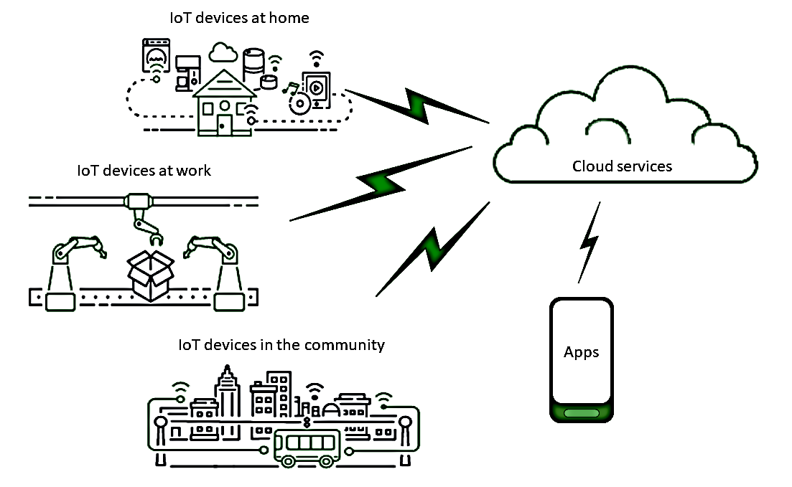
Bandwidth Cost
Bandwidth is one of the challenges because of continues data transferring from the IoT devices.
IoT is all about data, and in most cases, this would be big data. Hence, huge investment in storage is needed.
Cloud computing is preferred for storage and processing in IoT.
Small-scale IoT application demanding lesser resources.
But if the application is data concentrated, then the investment in bandwidth would be considerable.

Slide 17
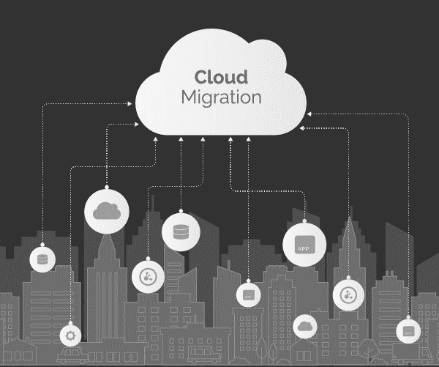
Migration and Portability
When data is to be moved to or migrate from the cloud, we have to take care of the followings.
How easy and safe is it to move the data?
How much downtime would this process require?
What is the strategy to migrate data to the cloud?
Will it be easy to select out of the cloud and take data back to the infrastructure?
How much would it cost?
Would there be support offered to migrate smoothly to another cloud service provider?
All these challenges are doubled with IoT as the data comes from the various sensory nodes at a very high speed.

Slide 18
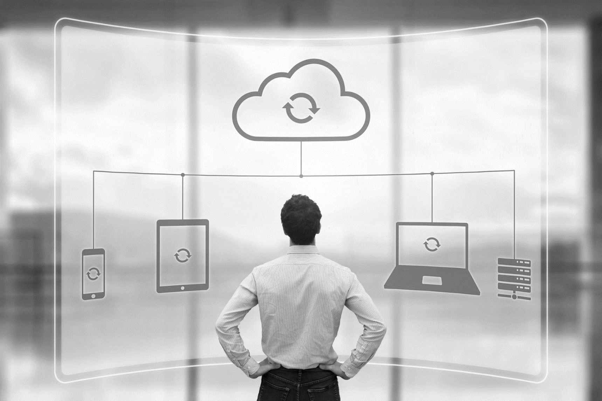
Availability, Reliability and Robustness
Continuous monitoring and reading of the data need to have continuous cloud service availability in IoT.
In downtime, it would miss critical data so reliability of the process has to be monitored.
The process should be robust towards handling data at different rates.
Data could be flooded or slowed at anytime, in the both situations it should be handled effortlessly.

Slide 19
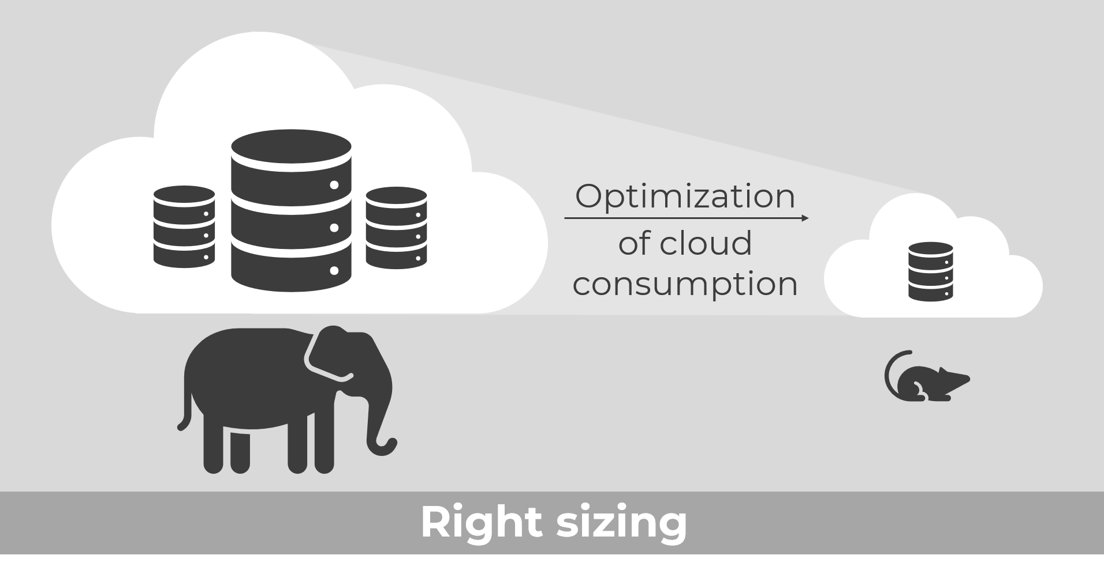
Costing
One of the main advantages of cloud is that it can scale up with rising demand.
While it is scalable and flexible, an organization should plan its budget carefully.
Wrong selection for subscription without having clear vision and planning, it may lead to unnecessary cost.

Slide 20
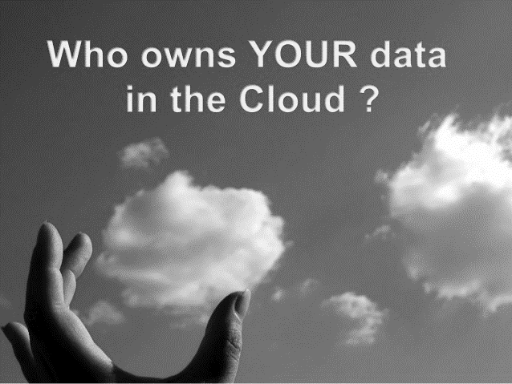
Data Ownership
The data stored by the user on the cloud is owned by the user.
This means that the data is under the ownership of the person who generates it.
However, when opting for cloud storage, the data is under the custody of the cloud service provider.
Then, it appears that the service provider owns the data.
When it comes to IoT, the data is generated at multiple points and ownership could lie with multiple participating parties.
Hence, in IoT the ownership-related challenges are multiplied.

Slide 21

Expertise
To use the cloud with IoT requires a specific skill set.
The cloud platform gets updated every now and then and so experts have to constantly upgrade themselves.
Expertise is a definite challenge.
When IoT and cloud comes together then it will be more challenging,
To understand the sensors and at the same time, to be updated on cloud development is a challenging task.

Slide 22
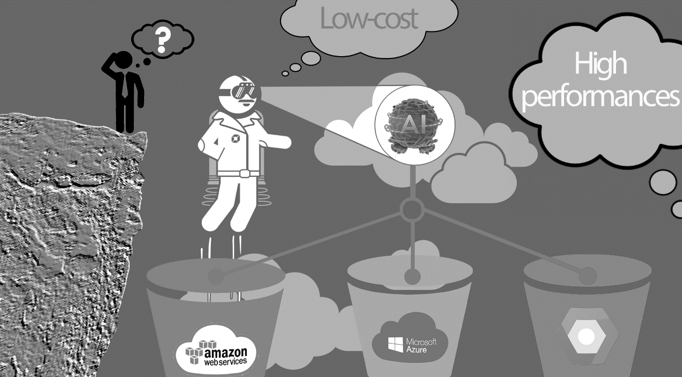
Selection of Cloud Service Provider: An Overview
There are many parameters to select cloud service providers from the numerous service providers.
It is advisable to consider following parameters while selecting the cloud service provider.
Certification and Standards Compliance
Financial Health of the Service Provider
Business and Technology Strength
Compliance Audit
Service Level Agreements
Reporting/Tracking
Costing and Billing
Maintenance Monitoring and Upgrade
Support
Security

Slide 23
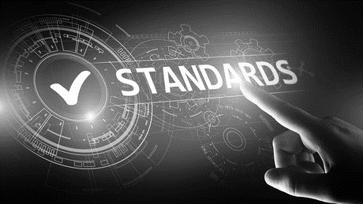
Criteria 1: Certification and Standards Compliance
When a product adheres to the standards that are accepted widely, it is considered as a reliable product. Similarly,
Cloud service providers (CSPs) are expected to comply with standards. Because product with standards are accepted widely, it is considered as a reliable product
Industry accepted standards is the first criteria to select the CSP.
Though there are many standards framed and followed by the industry, some of the main standards for cloud are ISO, Open Cloud Consortium (OCC), IEEE, SNIA (Cloud Storage Initiative).

Slide 24
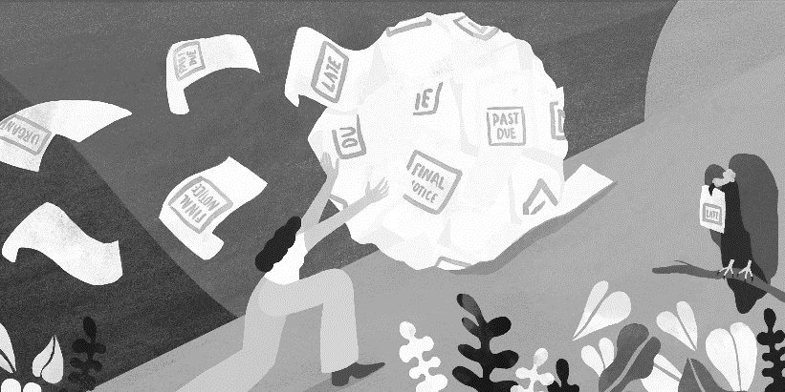

Criteria 2: Financial Health of the Service Provider
The service provider should hold sufficient funding to operate business for a long period.
If the service provider has healthy financial status and history of sustenance, then it is most unlikely to shut down.
Criteria 3: Business and Technology Strength
Having the technical expertise to sustain and adapt to a client's requirements is a key factor in selecting a CSP.
Having just the technical skill and strength does not help; the CSP needs business skills as well to sustain.
Business skills include growth planning, financial planning, and other factors that are required to sustain in the market.
Sustenance = Technology + Business Skills

Slide 25
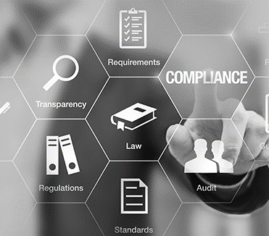
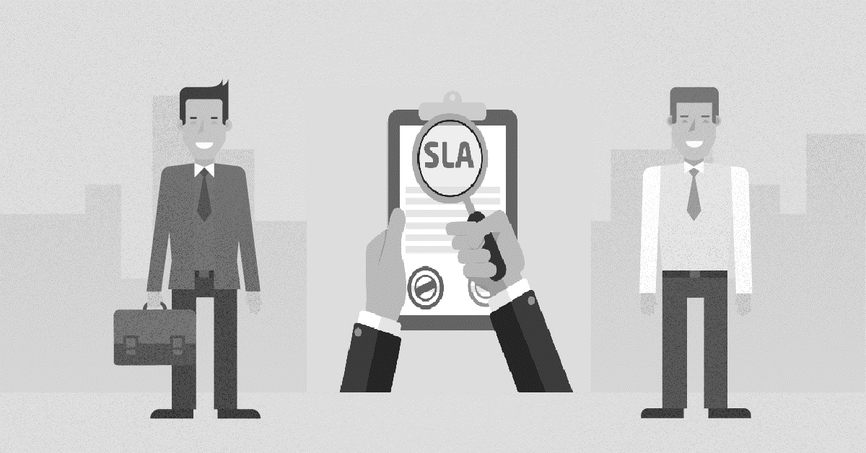
Criteria 4: Compliance Audit
The CSP must validate compliance with the client's requirement.
Which should be done through a proper third party audit.
This will enable transparency and perfect validation.
Criteria 5: Service Level Agreements
Service Level Agreements (SLAs) provides detail information about the services being provided.
SLAs also indicates the real value that a customer gets out of them.
SLAs serve as a legal contract, define the terms & conditions and the relationship between the two parties.

Slide 26


Criteria 6: Reporting/Tracking
The service provider should be capable for issuing a complete performance report, which also highlights the problems.
This will enable the customer to understand the complete situation.
Criteria 7: Costing and Billing
The costing and billing should be transparent and should provide the complete details of the usage.
It is expected to be automated with details of the complete resource utilization.
It should with having clarity along with the breakup.
This means the billing should be transparent and for the usage only.
This is a major factor in selecting the CSP.

Slide 27
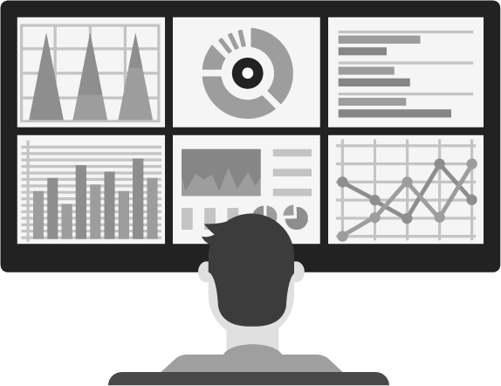
Criteria 8: Maintenance Monitoring and Upgrade
It should be easy and less expensive to migrate to the CSP's environment.
When there is an upgrade, it should be done with ease.
Any maintenance should be easy and affordable.
In short, it should be easier to install, manage, maintain, and upgrade.
This upgrade includes migration from private to public to hybrid cloud, if needed.

Slide 28
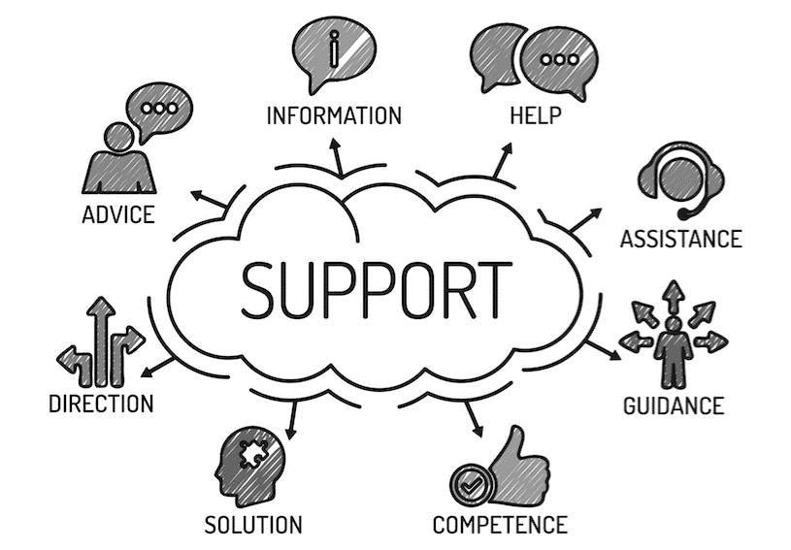
Criteria 9: Support
Help and assistance should be provided when required.
Support should be available based on the agreements and a dedicated resource.
Support levels based on complexity of problem.
Onsite support may be needed when clarifications cannot be offered over phone or online.
Thus, support is a major deciding factor for selection of a service provider.

Slide 29
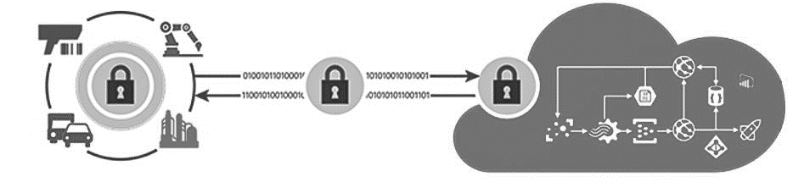
Criteria 10: Security
The infrastructure, both hardware and software should be secured.
There should be defined policies about the security that should also be shared with a customer.
This includes everything, from access restrictions to customer data.
The data should be safe in case of a breakdown/failure.
The recovery and backup options should be sound.
The physical infrastructure has to be safeguarded as well.
All these factors would require audit, which should be carried out by a third party.
Security is the prime concern and cannot be ignored.
Evaluation should start from this point.

Slide 30
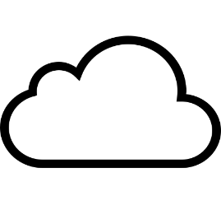
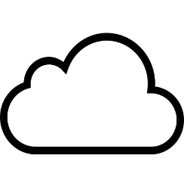
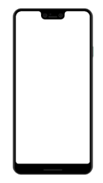
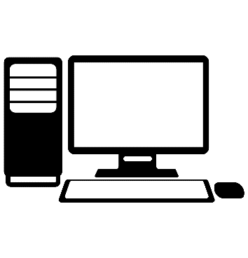
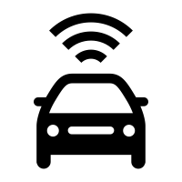
Introduction to Fog Computing
IoT is all about the data. The factors that affect data are the four Vs - variety, velocity, veracity and volume.
All IoT applications require instant analysis and action.
Most of the time, the action would be corrective in nature, it would be business critical.
In case the data volume is high and it reaches the cloud after some delay.
So we may lost the opportunity to use the data appropriately.
In such cases, fog computing serves the solution.
Cloud Service
Cloud
Fog
Computing
Fog
Fog
Fog
Edge Devices

Slide 31
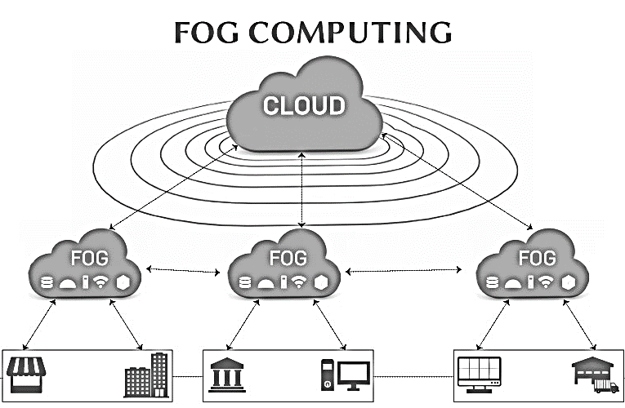
Introduction to Fog Computing
The most sensitive data should be analyzed in the area closer to the place where it is generated.
With fog computing, it is possible.
Using fog computing we can process the data locally and to avoid the trouble by not sending the data to the cloud.
Respond much faster because of data is moving locally so data travel is reduced considerably.
It thus process the data in milliseconds.

Slide 32
Introduction to Fog Computing
Only the required data will be sent to the cloud.
This will be based on storage requirements and guidelines.
Predictive analytics can also be carried out with the data stored in the cloud.
The fog is below cloud, which means it is closer to the elements that generate data.
After analysis, the data stored is pushed on to the cloud.
Results in increased efficiency and safety both physical and asset safety.
Some examples where faster response time is extremely important are factory or manufacturing line, oil and gas tube lines fault analysis, on-flight diagnosis, and healthcare.

Slide 33
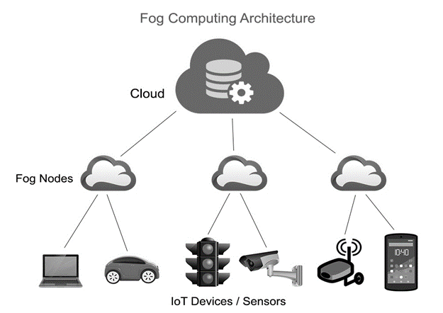
Working of Fog Computing
Sensors/devices generate data transmit it to the middle layer, which is very close the data source.
These nodes in the middle layer are capable of handling the data.
This requires minimum power and lesser resources.
All the data need not go to the cloud at the instant.
Also, sensitive data gets processed very fast, which results in an instant response.
Fog is not meant for hefty storage. It is still the cloud that does the task of storing big data.
Fog is just an intermediary layer for faster data processing, and the faster response time.

Slide 34
Summarize the concepts
Concept of fog nodes
It receives the data feed from the sensors, in real-time.
Response time is minimal, ideally in milliseconds.
Fog computing is transit, where data is stored for a limited time only.
Data is then sent to cloud as a summary.
It is important to note that not all data goes to the cloud.
Concept of cloud computing platform
It receives the data summary from the fog.
Data prediction, data analytics, data storage, etc. takes place here.

Slide 35
Benefits of fog computing model
Minimal amount of data sent to the cloud.
Reduced bandwidth consumption.
Reduced data latency.
Improved data security. When limited data goes to cloud, it is easier to protect it.
Immediate processing of data in real time (this is very much needed in industrial applications).

Slide 36
Difference between Edge and Fog Computing
Both fog and edge are concerned with the computing capabilities to be executed locally, before passing it to the cloud.
Both aim at reducing complete dependency on the cloud to perform computation.
Analyzing data and processing it at the cloud is to be avoided.
Both these reduce the time delay for making faster decision for real-time applications.
The main difference between edge and fog computing is where data processing takes place.
Edge computing is the computing carried out at the device itself, where all the sensors are-connected.
In fog computing, data processing is moved to the processors that are connected to the local area network (LAN), making it a little farther from the sensors and actuators.
Thus, the main difference between edge and fog computing is the distance.

Slide 37
Cloud Computing: Security Aspects
The security of any computing platform including cloud computing depends on
Software security,
Infrastructure security,
Storage security, and
Network security,
If any of these is compromised, it would result in security violation and could cause damages.
Let us discuss these security aspects briefly.

Slide 38
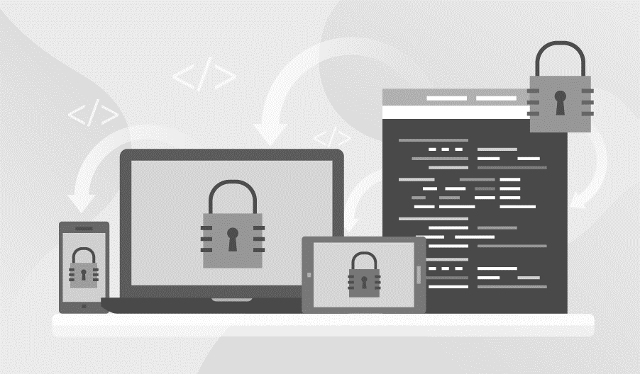
Cloud Computing: Security Aspects
1. Software Security:
Software is the core component and plays a vital role in presenting and ensuring a secure environment.
If there are defects created/generated during the development phase, it is a software security threat.
Defects such as simple software implementation defects, memory allocation, design issues, and exception handling all contribute to security issues.
This can be ensured by complete and comprehensive testing carried out at all-stages.

Slide 39
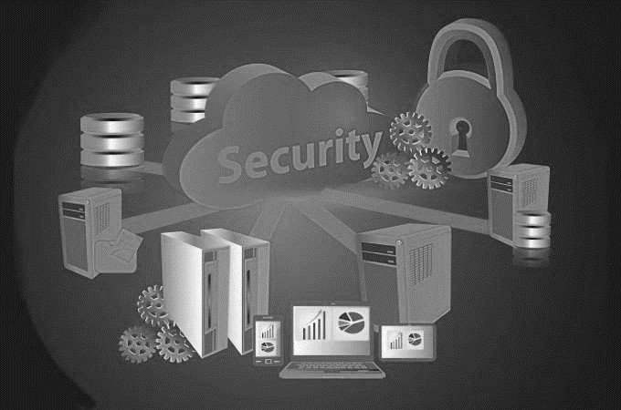
Cloud Computing: Security Aspects
2. Infrastructure Security:
Making sure that the infrastructure provided by the CSP is safe is a must.
Third party could also contribute to the infrastructure.
It is extremely important to check the security vulnerabilities with the infrastructure.
All infrastructure related guidelines should be mentioned clearly in the agreements and should be made transparent to the customer.
If data is damaged, everything is damaged and lost.
Hence, care should be taken to protect the infrastructure.

Slide 40
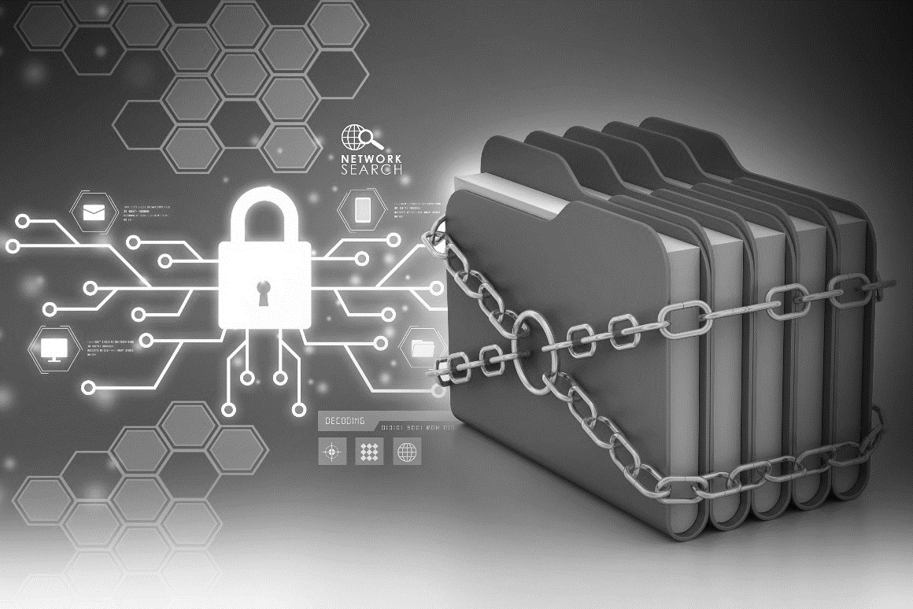
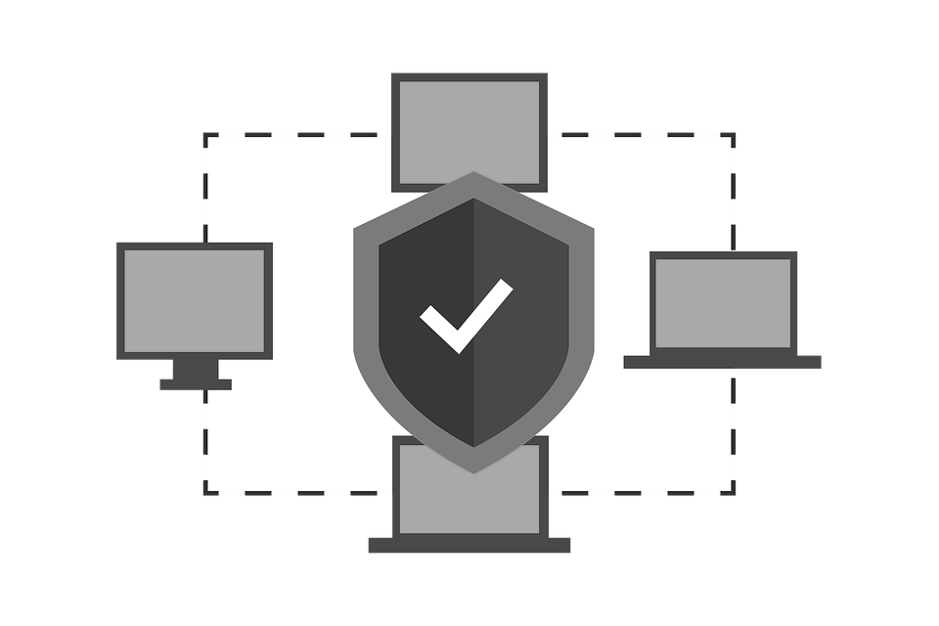
Cloud Computing: Security Aspects
3. Storage Security:
It is important to be informed of who owns the data and the location where it is stored.
Data leak, snooping, malware attacks, etc. are all threats to the stored data and can be listed under storage security.
Appropriate antivirus software and periodic monitoring, should help protect the data.
4. Network Security:
Data is stored in the cloud via the Internet, and hence all network threats become a possibility.

Slide 41
Summary
Cloud computing has become one of the most used technology components in modern day applications, which not only provides storage but also supports data analytics.
Cloud services could be any one of the following:
Software as a Service (SaaS): Complete software application as a service is provided to the user.
Platform as a Service (PaaS): Development tools, APIs, libraries, etc. will be divided by the cloud service provider. User have to build, manage and maintain the applications.
Infrastructure as a Service (IaaS): User should be provided with virtual machine support, where the user does not need to know and worry about the infrastructure. Everything should be taken care by the service provider. User will manage the machines, select the OS and underlying applications.
The three deployment models generally used for public, private and hybrid
Private cloud deployment model can be opted wherever confidentiality matters the most.
When its come to public cloud deployment model, the cloud service provider owns all the resource which include hardware/infrastructure and software. Cloud service provider will take care of all resource management.

Slide 42
Summary
Hybrid development is a mix of both public and private deployment model. In this approach the resource offered and manage are both in-house and third party based.
There are many challenges one could face while opting for cloud storage with IoT applications some of these are as follows:
Privacy and security
Bandwidth cost
Migration and portability
Reliability and availability
Costing
Data ownership
Expertise
Selecting a CSP is not easy. Many parameters are to be considered before choosing the best option.
With fog computing, it become possible to analyze the data at a place closer to where it is generated.

Slide 43
Summary
Fog computing provides the following advantages:
Minimal amount of data send to cloud
Reduce bandwidth consumption
Reduce data latency
Improve data security
Immediate processing of data

